Slide 1
ER-Diagram
Unit-2 Cont….

Slide 2
ER Model to Relational Model
ER diagrams mainly comprise of − Entity and its attributes Relationship, which is association among entities.
STEP 1:
Mapping Entity Process Algorithm
Create table for each entity.
Entity's attributes should become fields of tables with their respective data types.
Declare primary key.
Example: We create the relations EMPLOYEE, DEPARTMENT, and PROJECT in the relational schema corresponding to the regular entities in the ER diagram.
SSN, DNUMBER, and PNUMBER are the primary keys for the relations EMPLOYEE, DEPARTMENT, and PROJECT as shown.

Slide 3
ER Model to Relational Model (Cont…)
STEP 2:
Mapping Relationship Process Algorithm
Create table for a relationship if it is a n:m (many to many)relationship.
Add the primary keys of all participating Entities as fields of table with their respective data types.
If relationship has any attribute, add each attribute as field of table.
Declare a primary key composing all the primary keys of participating entities.
Declare all foreign key constraints.
Example: The M:N relationship type WORKS_ON from the ER diagram is mapped by creating a relation WORKS_ON in the relational database schema.
The primary keys of the PROJECT and EMPLOYEE relations are included as foreign keys in WORKS_ON and renamed PNO and ESSN, respectively.
Attribute HOURS in WORKS_ON represents the HOURS attribute of the relation type. The primary key of the WORKS_ON relation is the combination of the foreign key attributes {ESSN, PNO}.

Slide 4
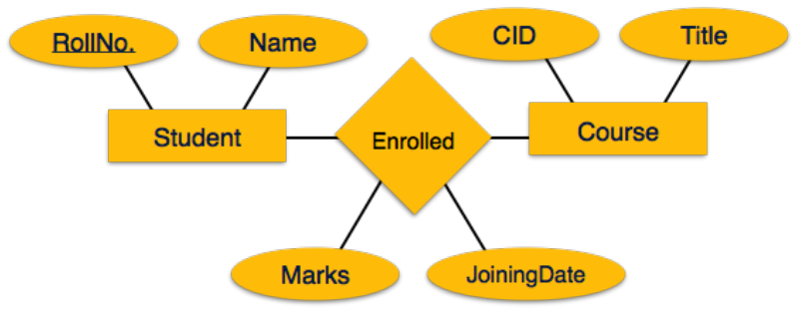
Create a table for Enrolled with fields: (Roll_No, CID, Marks, JoiningDate)

Slide 5
Mapping Relationship type
Mapping of Binary 1:1 Relation Types
For each binary 1:1 relationship type R in the ER schema, identify the relations S and T that correspond to the entity types participating in R.
There are three possible approaches:
Foreign Key approach: Choose one of the relations-say S-and include a foreign key in S the primary key of T. It is better to choose an entity type with total participation in R in the role of S.
Example: 1:1 relation MANAGES is mapped by choosing the participating entity type DEPARTMENT to serve in the role of S, because its participation in the MANAGES relationship type is total.
Merged relation option: An alternate mapping of a 1:1 relationship type is possible by merging the two entity types and the relationship into a single relation. This may be appropriate when both participations are total.
Cross-reference or relationship relation option: The third alternative is to set up a third relation R for the purpose of cross-referencing the primary keys of the two relations S and T representing the entity types.

Slide 6
Mapping Relationship type
Mapping of 1 : N Relationship
For each regular binary 1:N relationship type R, identify the relation S that represent the participating entity type at the N-side of the relationship type.
Include as foreign key in S the primary key of the relation T that represents the other entity type participating in R.
Include any simple attributes of the 1:N relation type as attributes of S.
Example: 1:N relationship types WORKS_FOR, CONTROLS, and SUPERVISION in the figure.
For WORKS_FOR we include the primary key DNUMBER of the DEPARTMENT relation as foreign key in the EMPLOYEE relation and call it DNO.

Slide 7
Mapping Relationship type
Mapping of N-ary Relationship.
For each n-ary relationship type R, where n>2, create a new relationship S to represent R.
Include as foreign key attributes in S the primary keys of the relations that represent the participating entity types.
Also include any simple attributes of the n-ary relationship type (or simple components of composite attributes) as attributes of S.
Example: The relationship type SUPPY in the ER on the next slide.
This can be mapped to the relation SUPPLY shown in the relational schema, whose primary key is the combination of the three foreign keys {SNAME, PARTNO, PROJNAME}

Slide 8
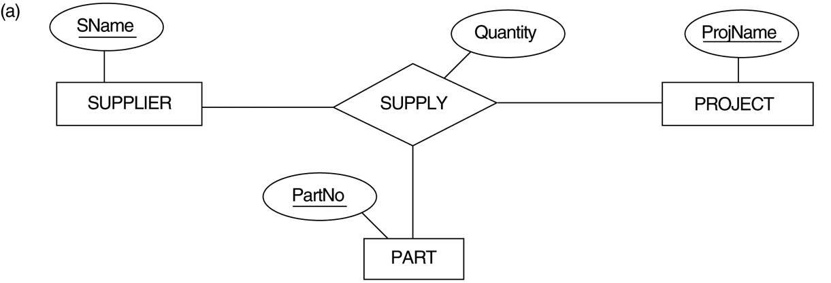
FIGURE 4.11 Ternary relationship types. (a) The SUPPLY relationship.

Slide 9
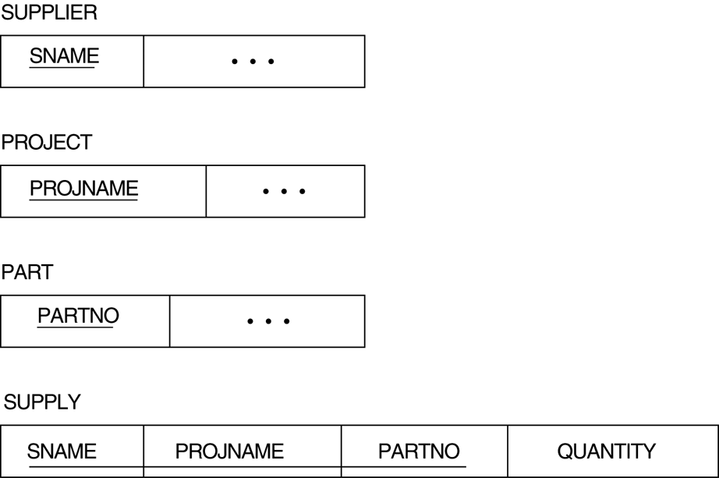
FIGURE 7.3 Mapping the n-ary relationship type SUPPLY from Figure 4.11a.

Slide 10
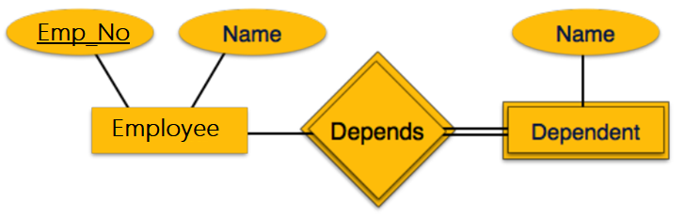
ER Model to Relational Model (Cont…)
STEP 3:
Mapping Weak Entity Sets Process Algorithm
Create table for weak entity set.
Add all its attributes to table as field.
Add the primary key of identifying entity set.
Declare all foreign key constraints.

Slide 11
ER-to-Relational Mapping Algorithm (contd.)
Step 4: Mapping of Multivalued attributes.
For each multivalued attribute A, create a new relation R.
This relation R will include an attribute corresponding to A, plus the primary key attribute K-as a foreign key in R-of the relation that represents the entity type of relationship type that has A as an attribute.
The primary key of R is the combination of A and K. If the multivalued attribute is composite, we include its simple components.
Example: The relation DEPT_LOCATIONS is created.
The attribute DLOCATION represents the multivalued attribute LOCATIONS of DEPARTMENT, while DNUMBER-as foreign key-represents the primary key of the DEPARTMENT relation.
The primary key of R is the combination of {DNUMBER, DLOCATION}.

Slide 12
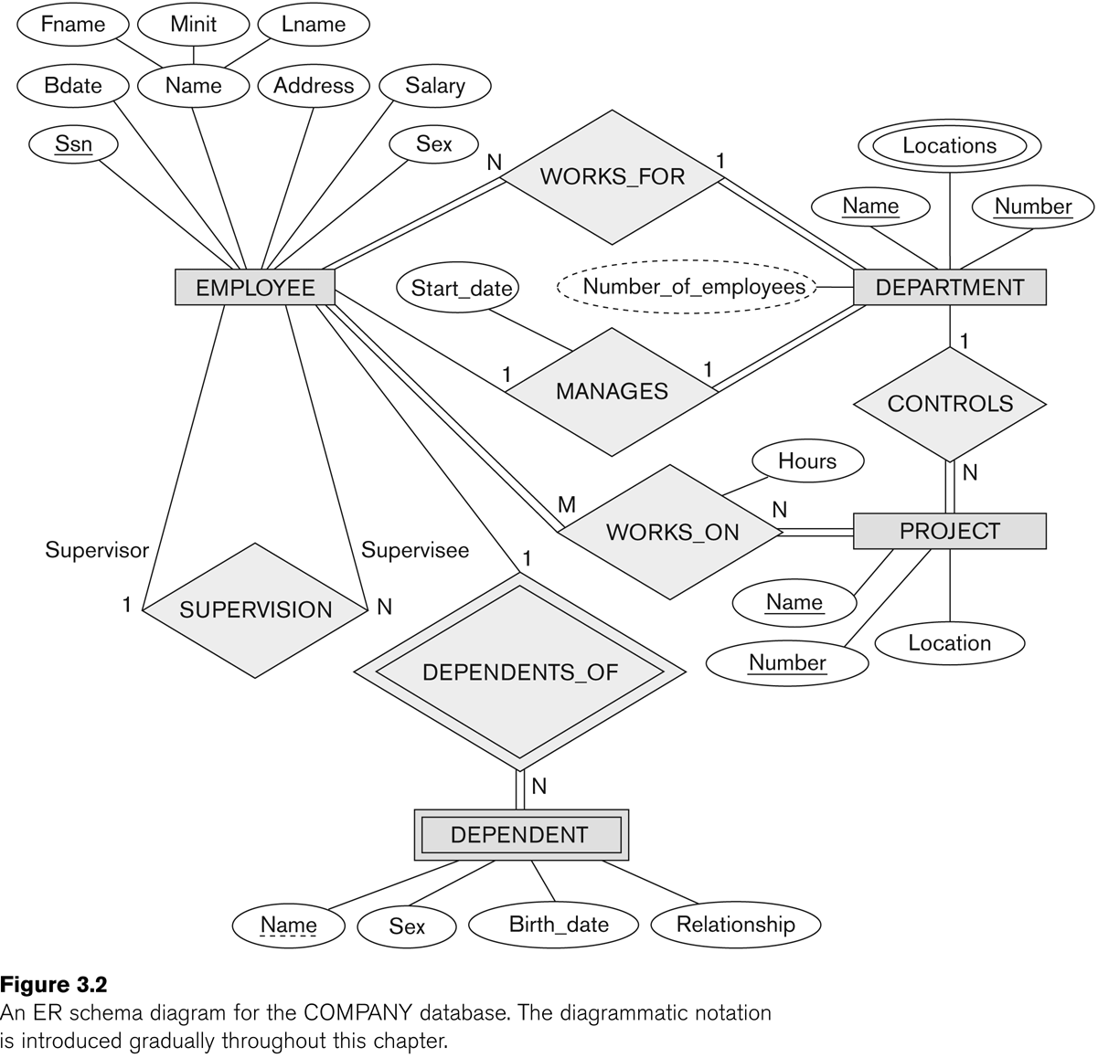
Example

Slide 13
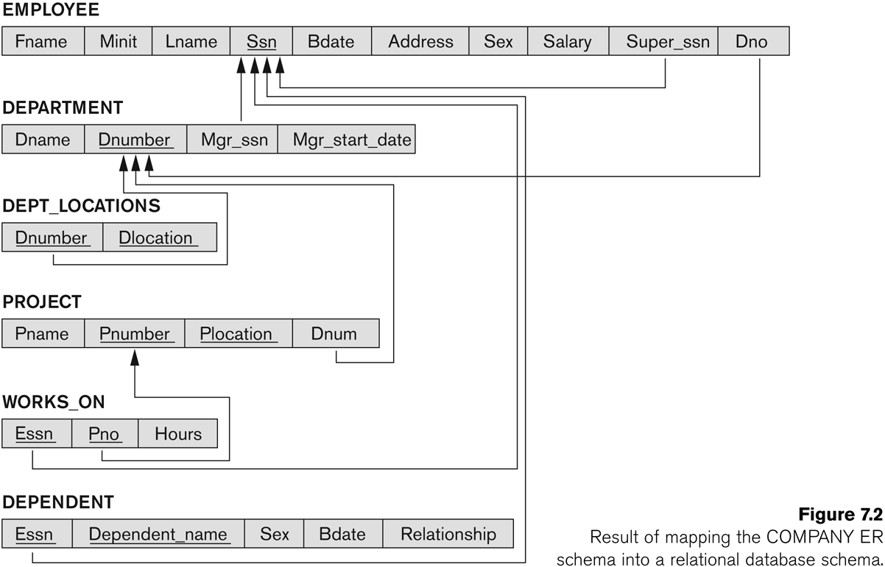
FIGURE 7.2 Result of mapping the COMPANY ER schema into a relational schema.

Slide 14
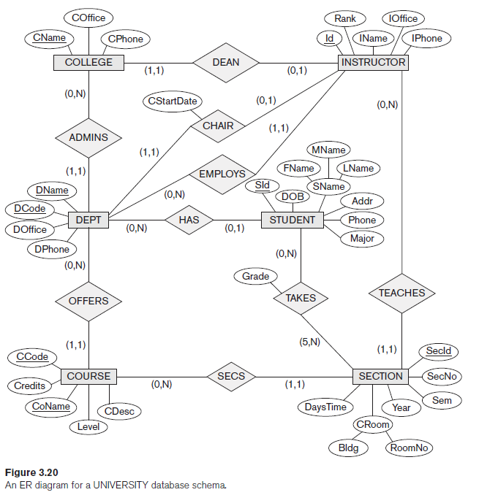
Example

Slide 15
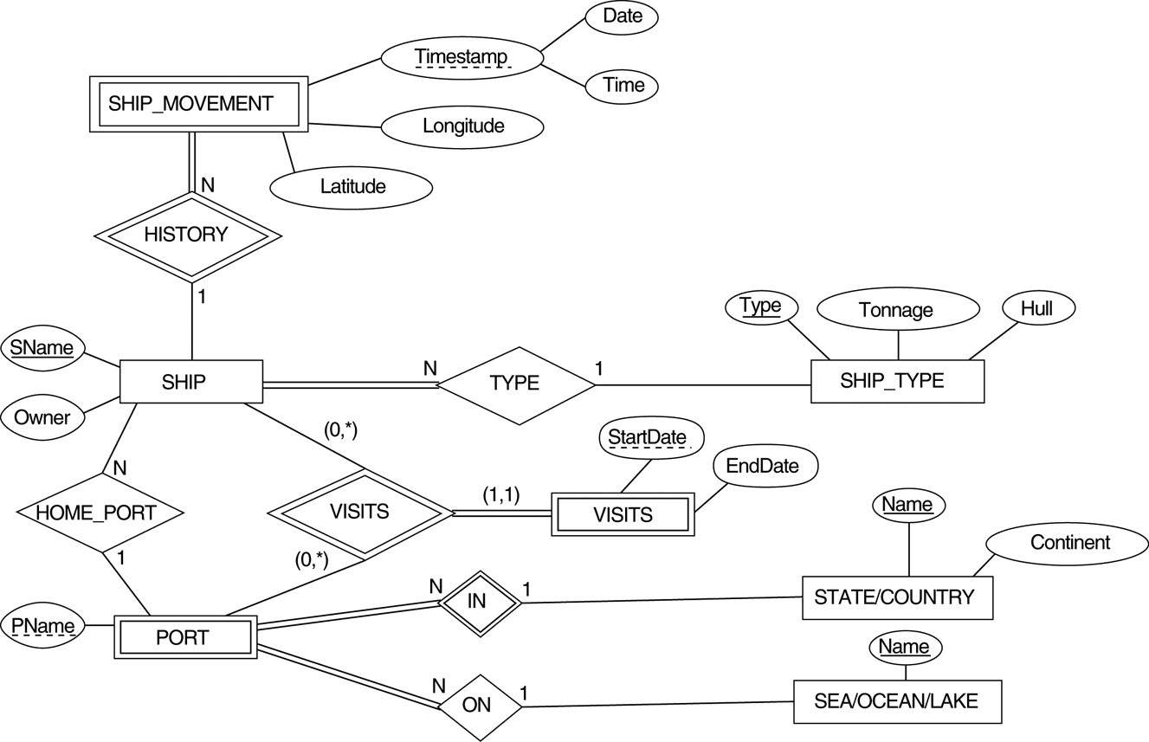
Mapping Exercise
Exercise 7.4.
FIGURE 7.7 An ER schema for a SHIP_TRACKING database.

Slide 16
Practical - JOIN
In relational databases, such as SQL Server, Oracle, MySQL, and others, data is stored in multiple tables that are related to each other with a common key value. Accordingly, there is a constant need to extract records from two or more tables into a results table based on some condition. In SQL Server, this can be easily accomplished with the SQL JOIN clause.
JOIN is an SQL clause used to query and access data from multiple tables, based on logical relationships between those tables.
In other words, JOINS indicate how SQL Server should use data from one table to select the rows from another table.

Slide 17
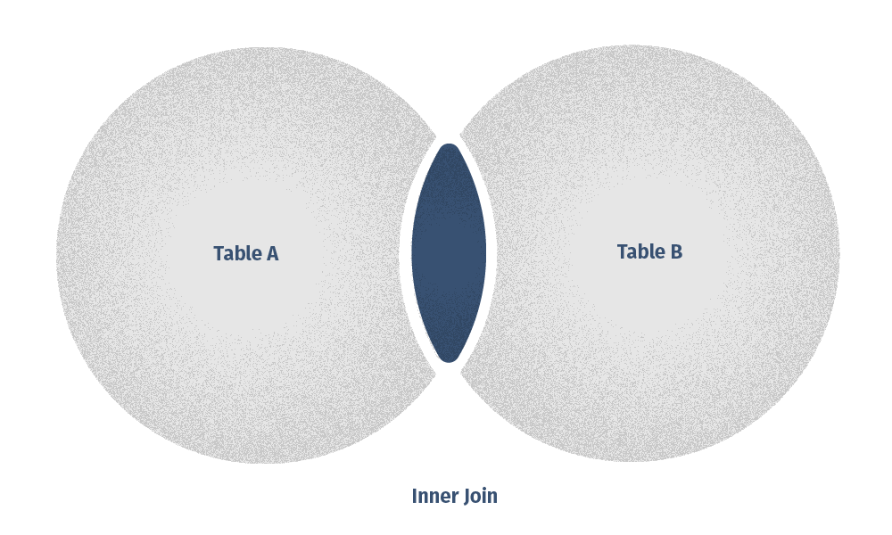
Inner join
INNER JOIN statement returns only those records or rows that have matching values and is used to retrieve data that appears in both tables.

Slide 18
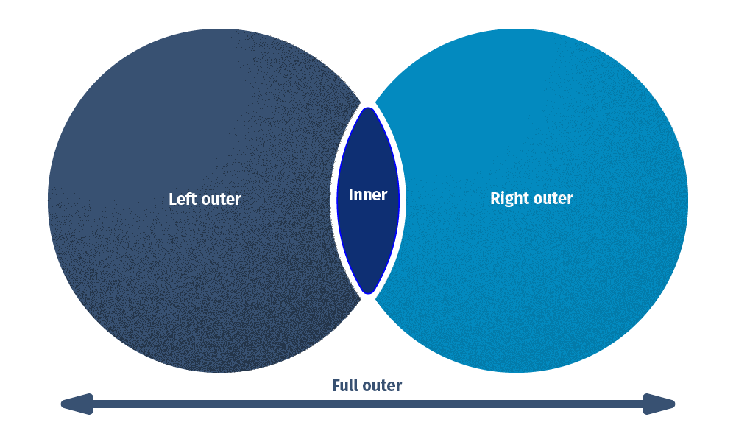
Outer Join – Left Outer and Right Outer
OUTER JOIN, will retrieve not only the matching rows but also the unmatched rows as well.

Slide 19
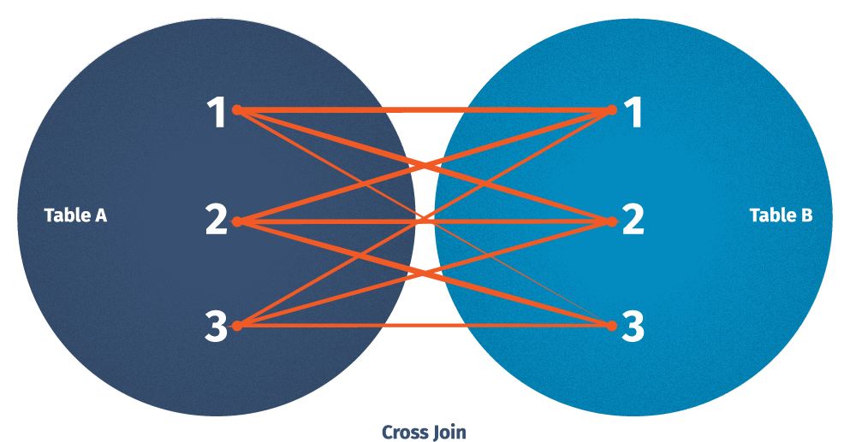
Cross Join
The CROSS JOIN command in SQL, also known as a cartesian join, returns all combinations of rows from each table. Envision that you need to find all combinations of size and color. In that case, a CROSS JOIN will be an asset. Note, that this join does not need any condition to join two tables. In fact, CROSS JOIN joins every row from the first table with every row from the second table and its result comprises all combinations of records in two tables.

Slide 20
Syntax
SELECT Table1.Column1,Table1.Column2,Table2.Column1,....
FROM Table1
INNER JOIN Table2
ON Table1.MatchingColumnName = Table2.MatchingColumnName;
SELECT Table1.Column1,Table1.Column2,Table2.Column1,....
FROM Table1
FULL JOIN Table2
ON Table1.MatchingColumnName = Table2.MatchingColumnName;
Similarly can write for Left Join an Right Join

